Slide 1



Department of Computer Science and Engineering
MOTION CONTROLLED COMPUTER USING ARDUINO
Yaashish G(210701317)
Yar Zar Min(210701318) Shiyaam Prasad V (210701321)
Ms. S. Ponmani Assistant professor

Slide 2
INTRODUCTION OF MOTION CONTROLLED COMPUTER USING ARDUINO
The technology tends to make human life easier and safer, our main aim is to reduce the effort of interaction with computers or laptops through input devices using simple gestures as gesture-based interaction are becoming very popular both at the workplace. Our project is kind of similar to that but here we use hand motion to control our personal computer. This work intends to develop a system that can recognize hand gestures which can be used as an input command to interact with the PC or laptop. One of the key areas which need to be looked at while developing such systems is the code implementation stage. To manage the work we shall also be using Python for the implementation of the code. We feel that if successfully meet our goals then we shall have contributed towards the future of natural gesture-based interfaces, if only in a minimal way. Let’s have a brief look into the project with all the working analysis and results we achieved.

Slide 3
LITERATURE SURVEY
SNO | TITLE | AUTHOR | JOURNAL | YEAR PUBLISHED | CONTRIBUTION
1 | Cost-effective hand gesture computer control interface | József Katona Gergely Sziládi Tibor Ujbányi | IEEE International Conference on Cognitive Info communications | 2016 | Provided a rich dataset for gesture research, capturing spontaneous and naturalistic gestures in computer interactions.
2 | Hand Gesture Recognition Based on Computer Vision: A Review of Techniques | Sushmita Mitra Acharya Tinku | IEEE Transactions on Systems, Man, and Cybernetics | 2007 | Applications involving hidden Markov models, particle filtering and condensation, finite-state machines, optical flow, skin color, and connectionist models

Slide 4
s.no | TITLE | AUTHOR | JOURNAL | YEAR PUBLISHED | CONTRIBUTION
3 | Static vision based Hand Gesture recognition using principal component analysis | Mandeep Kaur Ahuja Amardeep Singh | IEEE 3rd International Conference on MOOCs, Innovation, and Technology in Education (MITE) | 2015 | Template-based matching technique is developed using Principal Component Analysis (PCA) for recognition.
4 | A Continuous Hand Gestures Recognition Technique for Human-Machine Interaction Using Accelerometer and Gyroscope Sensors | Tanima Dutta Kulwant Sharma Hari Prabhat Gupta | IEEE Sensors | 2016 | A gesture is recognized by comparing the gesture code with the gesture database using a dynamic time warping algorithm
5 | Real-Time Hand Gesture Recognition Using a Color Glove | Luigi Lamberati Francesco Camastra | Image Analysis and Processing | 2011 | This paper presents a real-time hand gesture recognizer based on a color glove.

Slide 5
SNO | TITLE | AUTHOR | JOURNAL | YEAR PUBLISHED | CONTRIBUTION
6 | Vision-based hand-gesture applications | Juan Pablo Wachs Yael Edan | Communications of the ACM | 2011 | Body posture and finger pointing are a natural modality for human-machine interaction.
7 | Study of various techniques of Hand gesture recognition | Jyoti Rani Harpreet Kaur | IEEE 1st International Conference on Power Electronics, Intelligent Control and Energy Systems (ICPEICES) | 2016 | The Kinect depth data is the famous research for the identification of new fingers and the recognition of hand gesture
8 | Hand-Gesture Recognition-Algorithm based on Finger Counting | M.Perimal S.N.Basah H.Yahya | Exploring Man-Machines Compliance in Signal Processing and Artificial Intelligence | 2018 | The algorithm counts fingers and recognizes gesture based on the maximum distance between the fingers detected. The algorithm divided into four main parts: image acquisition, pre-processing, finger detection, and gesture recognition

Slide 6
SNO | TITLE | AUTHOR | JOURNAL | YEAR PUBLISHED | CONTRIBUTION
9 | Real-time hand detection in a complex background | Ekaterini Stergiopoul Parado Nu bailo Nikos Mitianoudiu | Image Processing and Multimedia Laboratory | 2014 | Employing a combination of existing techniques, based on motion detection and introducing a novel skin color classifier to improve segmentation accuracy.
10 | Real-time Vision-based Hand Gesture Recognition Using Haar-like Features | Ashish B Ingale DS Chaudhari | IEEE Instrumentation & Measurement Technology Conference IMTC 2007 | 2007 | Based on the extracted postures, composite, gestures can be parsed and recognized with a set of primitives and production rules.

Slide 7
PROBLEM STATEMENT
Design and implement a Motion-controlled computer interface using Arduino, enabling users to interact with digital devices seamlessly. The project aims to create a system that recognizes predefined hand gestures and translates them into corresponding computer commands, enhancing user experience and accessibility. The solution should encompass gesture detection using sensors or cameras, gesture classification algorithms, Arduino-based microcontroller programming, and effective communication protocols between the Arduino and the computer. This would be a great help for paralyzed people if they could control the system without any electronic gadget specified above. The system control with simple unique gestures of hands reduces the space between user and machine. In the present paper, basic Arduino Uno is used to support the hand gesture-based system control.

Slide 8
OBJECTIVES
To develop a robust motion system using Arduino and appropriate sensors/cameras.
To define a set of intuitive hand gestures to control various computer functions.
To Optimize the algorithm for efficient processing and minimal latency.
To Develop a user-friendly interface for configuring and customizing gesture commands.
To Conduct thorough testing to validate the accuracy and reliability of the hand gesture recognition system.

Slide 9
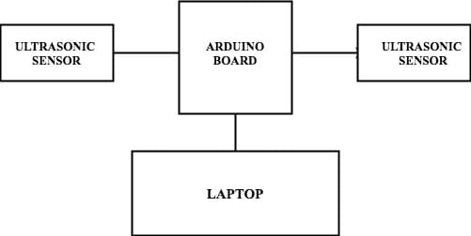
SYSTEM ARCHITECTURE

Slide 10
PROPOSED WORK
In our project ,We use Arduino and Python, there are several opportunities for enhancement and refinement. Firstly, to improve accuracy, we can fine-tune the distance thresholds in the Arduino code, ensuring precise detection of hand motions. Python's simplicity and readability make it easy to understand and write code, facilitating faster development. Additionally, Python seamlessly interfaces with Arduino, allowing effective communication between the sensor and the computer.
We leveraged the k-Nearest Neighbors (kNN) algorithm as a machine learning approach for gesture recognition. The kNN algorithm enhances our system's ability to accurately classify and interpret diverse hand movements. Through a training dataset comprising known hand gestures and their corresponding labels, the algorithm classifies new gestures based on the majority class among their k-nearest neighbors. This approach not only provides a robust framework for gesture recognition but also allows for adaptability and customization.

Slide 11
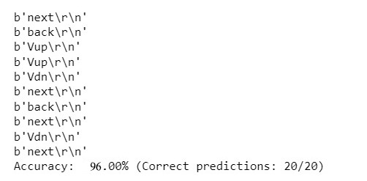
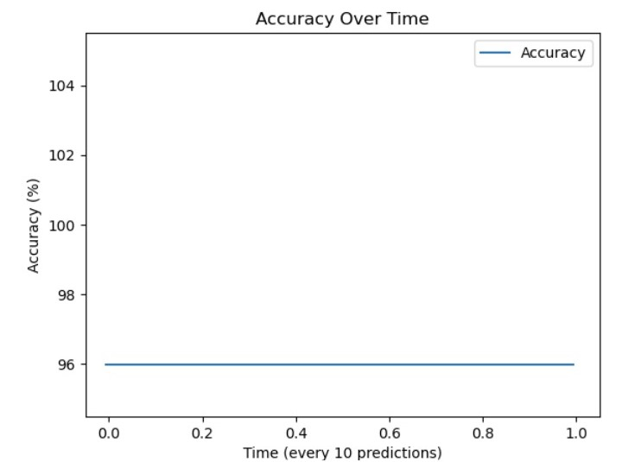
ACCURACY AND ALGORITHM
K-NEAREST NEIGHBOUR ALGORITHM (KNN):

Slide 12
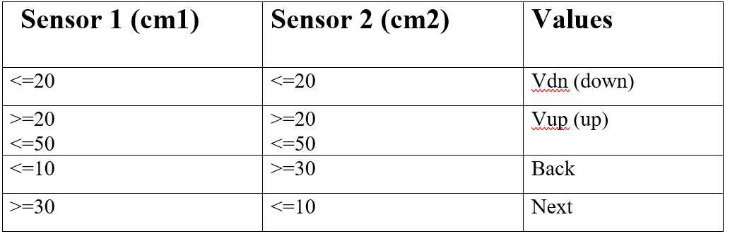
ACCURACY AND ALGORITHM

Slide 13
ACCURACY AND ALGORITHM
➔ The Motion- controlled computer data set consists of 4 features.
➔ When the cm1 (sensor 1) and cm2 (sensor 2) value is <=20 and <=20 then it gives the output as Vdn (down).
➔ When the cm1 and cm2 value is >=20 and <=50(cm1 values) and >=20 and <=50(cm2 values) then it gives the output as Vup (up).
➔ When the cm1 and cm2 value is <=10 and >=30 then it gives the output as Back.
➔ When the cm1 and cm2 value is >=30 and <=10 then it gives the output as Next.
➔ There is no null values in dataset.

Slide 14
HARDWARE REQUIREMENTS
ARDUINO UNO
ULTRASONIC SENSOR
JUMPER CABLE
USB CABLE

Slide 15
SOFTWARE REQUIREMENTS
OPERATING SYSTEM- WINDOWS 11
ARDUINO IDE
PYTHON IDLE
. Pyautogui

Slide 16
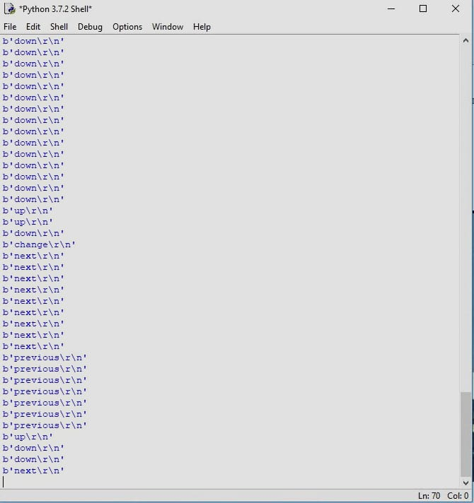
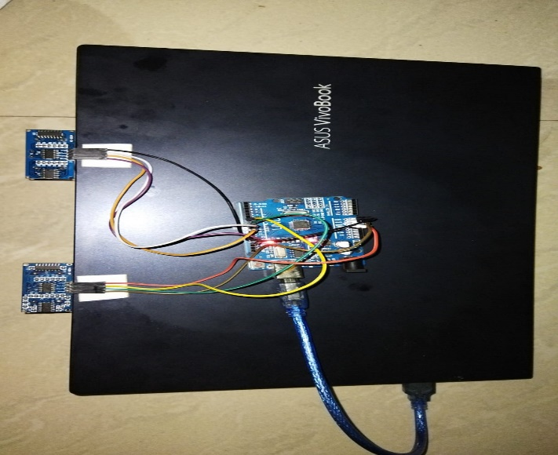
EXECUTION OUTPUT

Slide 17
RESULT ALONG WITH SCREENSHOT
The gesture recognition using ultrasonic waves is found to be accurate and reliable.
The methodology for testing comprised of movement of single hand or multiple hands.
Single hand movement was detected accurately.
When there are multiple hands, the movement is not detected accurately.
The noise in human audible range did not affect the detection.
In our work, we have implemented Arduino based motion controlled of our computer, where few hand gestures made in front of the computer will perform defined tasks in the computer without using keyboard.

Slide 18
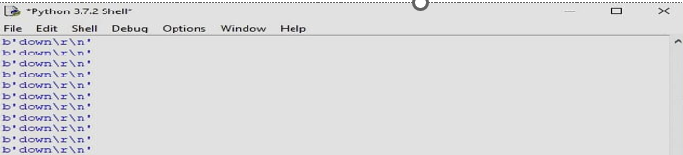
RESULT ALONG WITH SCREENSHOT

Slide 19
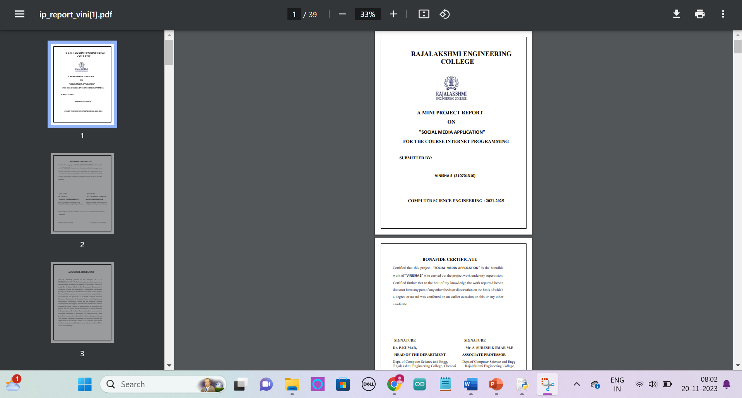
RESULT ALONG WITH SCREENSHOT

Slide 20
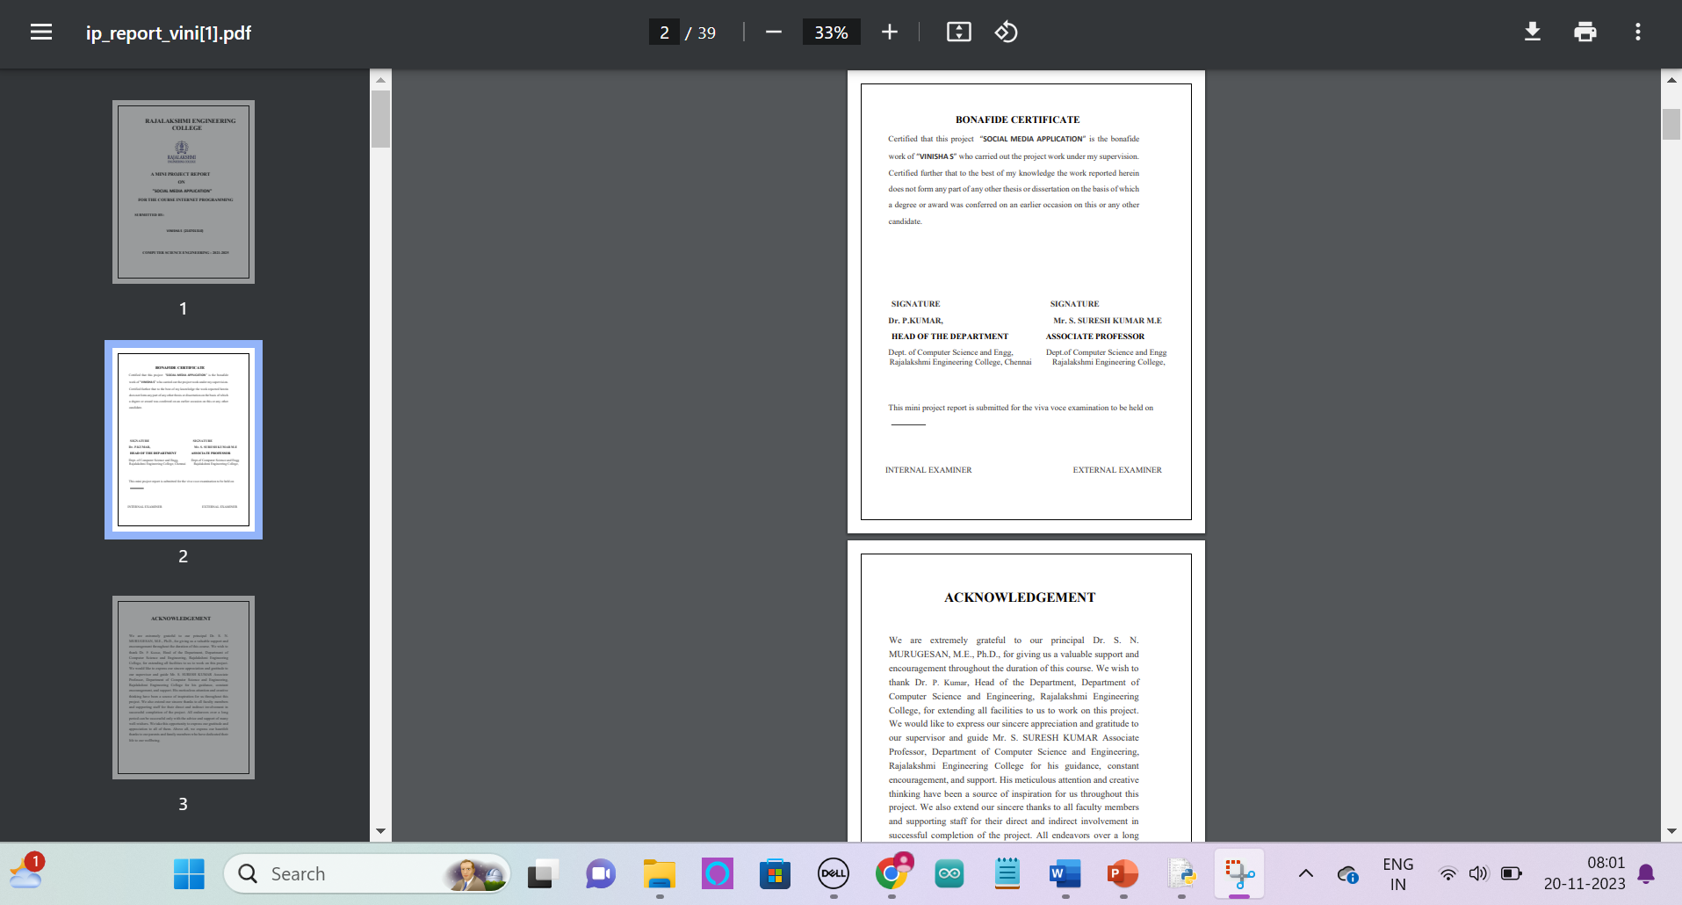
RESULT ALONG WITH SCREENSHOT

Slide 21

RESULT ALONG WITH SCREENSHOT

Slide 22
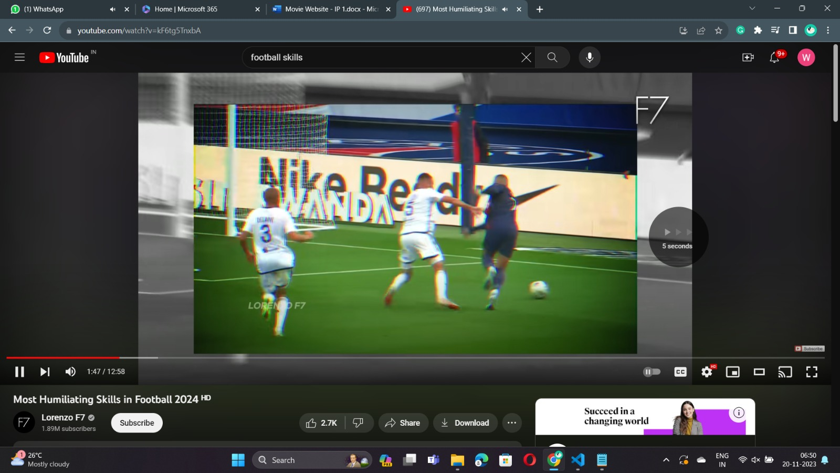
RESULT ALONG WITH SCREENSHOT

Slide 23

RESULT ALONG WITH SCREENSHOT

Slide 24
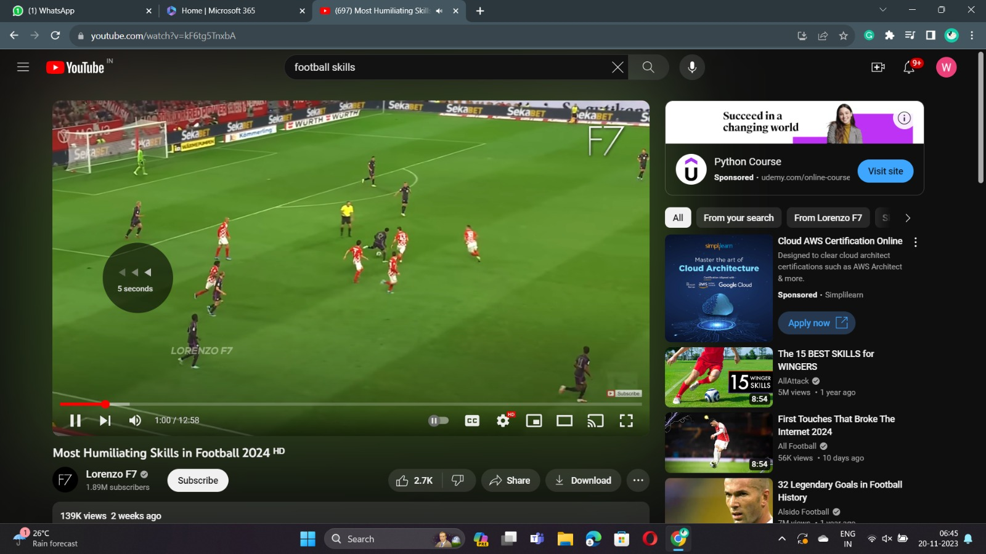
RESULT ALONG WITH SCREENSHOT

Slide 25
CONCLUSION
The motion-controlled computer project utilizing Arduino technology has successfully demonstrated the potential for intuitive and hands-free computer interaction. It is one of the easiest ways of interaction between humans and computers. It is a cost-effective model that is only based on Arduino UNO and ultrasonic sensors. The Python IDE allows seamless integration with Arduino UNO to achieve different processing and controlling methods for creating new gesture control solutions. Additional gesture recognition opportunities exist in medical applications where, for health and safety reasons, a nurse or doctor may not be able to touch a display or trackpad but still needs to control a system. In other cases, the medical professional may not be within reach of the display yet still needs to manipulate the content being shown on the display. Appropriate gestures, such as hand swipes or using a finger as a virtual mouse, are a safer and faster way to control the device.

Slide 26
REFERENCES
1. Zhigang, F. Computer gesture input and its application in human-computer interaction. Mini Micro Syst. 1999, 6, 418–421.
2. Mitra, S.; Acharya, T. Gesture recognition: A survey. IEEE Trans. Syst. Man Cybern. Part C Appl. Rev. 2007, 37, 311–324.
3. Ahuja, M.K.; Singh, A. Static vision-based Hand Gesture recognition using principal component analysis. In Proceedings of the 2015 IEEE 3rd International Conference on MOOCs, Innovation and Technology in Education (MITE), Amritsar, India, 1–2 October 2015; pp. 402–406.
4. Rajesh R.J, Nagarjunan. D, Arunachalam.R.M, Aarthi.R. Distance Transform Based Hand Gestures Recognition for PowerPoint Presentation Navigation. Adv. Comput. 2012, 3, 41..

Slide 27
Thank You

